Slide 1
Data Pipeline Design and Implementation MSDS610 Week-3 Assignment
Chennakeshava Akhil Pillalamarri
3043182

Slide 2
Agenda
1
2
3
4
5
Introduction
Data Quality & Issues
PostgreSQL Database Work
Implementation
Conclusion

Slide 3

Introduction
This pipeline shows the extraction of raw college data from PostgreSQL , apply data transformations, and stores the cleaned data in a structured format for further analysis.

Slide 4
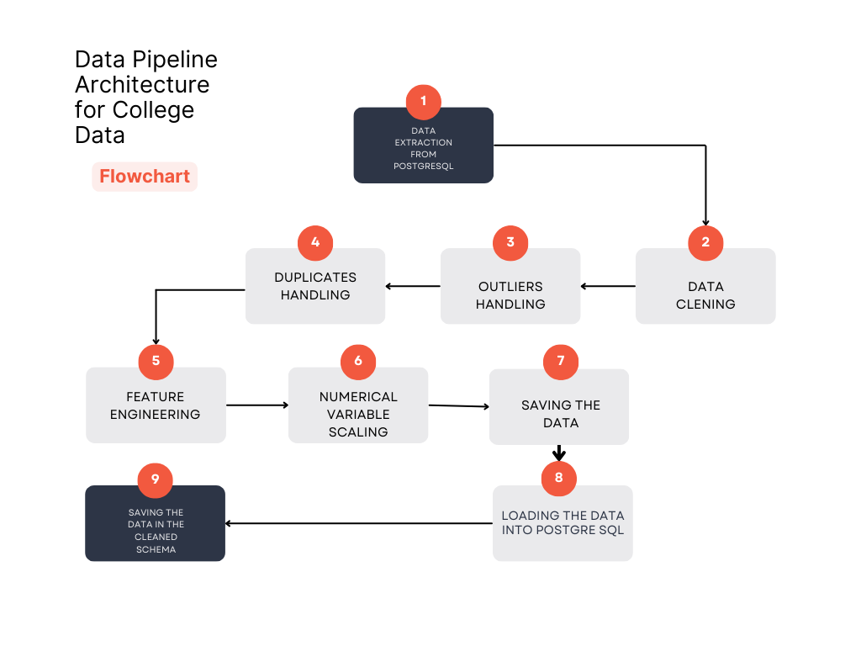
Pipeline Structure
Notes:
The goal of this pipeline is to clean and transform raw college data into a structured format that is easy to query and analyze. The major steps include data extraction from the raw database, transformations to enhance data quality, and storage in a cleaned schema for better usability.
This diagram outlines the complete data pipeline workflow, from extracting raw data to applying necessary transformations and finally storing the processed data in the cleaned schema.

Slide 5
Data Quality Issues
Outliers
Difference in Values
Categorical Encoding
Checked for the missing values but got outliers.
Handled those outliers using the pandas library
There was a difference in total number of students column and the sum of male and female columns.
Handled those differences by subtracting the difference.
Encoded all the categorical variables to numerical variables in a specific order.
Notes:
Three common data quality issues in the dataset include missing values, duplicates, and outliers. These can impact analysis and decision-making if not properly handled.
But in the dataset I have chosen, the issues were, Outliers, Difference in the Total Number of students with the sum of Male and Female students, and the categorical encoding. I have handled all these issues as you can see in the Jupiter notebook. And for validate those issues are resolved, I have checked the data over and over again.

Slide 6
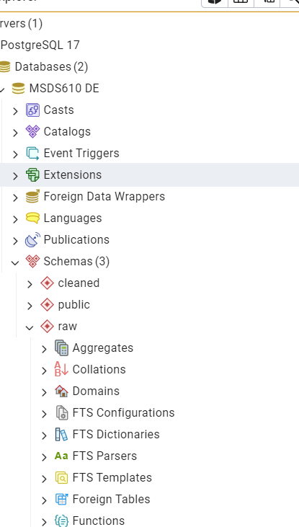
PostgreSQL Database Work
As shown in the fig, I have created the cleaned schema in the PostgreSQL, in which the cleaned data would be saved and loaded.
Notes:
The picture shows that I have created the schema named as Cleaned in the PGAdmin.

Slide 7
Implementation
1
Extraction
Extracting the dataset from PostgreSQL
2
Data Transformation
Handling the outliers, removing the difference and encoding the categorical data
3
Feature Engineering
Creating new columns with the existing variables which has a meaning and impact on our understanding.
4
Saving the Dataset
Saving the cleaned dataset to use it for loading in the cleaned schema.
5
Loading the Dataset
Loading the dataset in the cleaned schema and checking the PgAdmin if the data is loaded successfully.
Notes:
Here, we extract raw data from the raw schema and apply necessary transformations such as data cleaning, normalization, and encoding categorical variables.

Slide 8
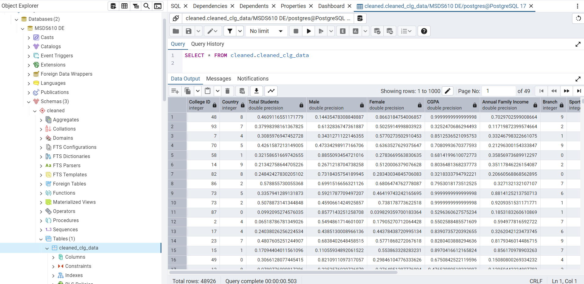
Data in the PostgreSQL
Notes:
Here is the picture of the PGAdmin, where I have successfully loaded the data in the cleaned schema.

Slide 9
Conclusion
As demonstrated in the Jupyter Notebook, I have successfully extracted data from PostgreSQL, cleaned it, and loaded it into a newly created schema for further analysis. This assignment has helped me understand the process of extracting data from a database and loading it into a new schema.

Slide 10
Thank you

